Slide 2
Build Jobs and Configurations

Slide 3

Learning Objectives
By the end of this lesson, you will be able to:
Explain build jobs in Jenkins
Trigger build jobs in Jenkins
Configure build notifications in Jenkins
Build projects in various languages
Create parameterized build jobs

Slide 4
Understanding Jenkins Build Jobs

Slide 5
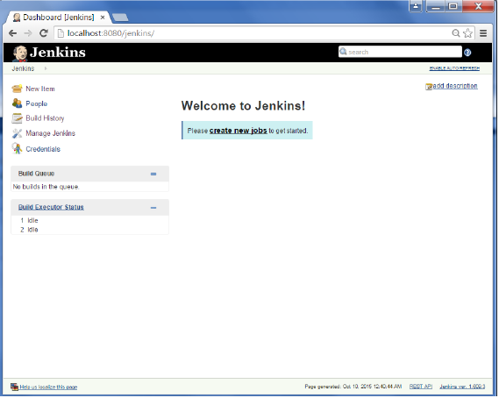
Creation of Jenkins Build Jobs
You can create new build jobs by clicking on the New Item button shown in the UI below. This will give you the list of build jobs available in Jenkins to choose from.
Notes:
Trainer Notes: Explain the topic

Slide 6
Types of Build Jobs
Jenkins supports four types of build jobs. They are:
Freestyle software project
Maven project
External job
Multi-configuration job
Notes:
Trainer Notes: Explain the topic
You can also create a new job by copying an existing job.

Slide 7
Types of Build Jobs
Freestyle software project:
Freestyle build jobs are general-purpose build jobs.
They provide maximum flexibility.
Maven project:
The maven project is specially adapted to Maven projects.
Jenkins interprets the Maven pom files and project structures to create a basic setup for your project.
Notes:
Trainer Notes: Explain the topic

Slide 8
Types of Build Jobs
External job:
The external job option helps you monitor non-interactive processes, like cron jobs.
Multi-configuration job:
The Multiconfiguration job is also known as the matrix job.
It lets you run the same build job with different configurations.
It is used for testing an application in different environments, with different databases, or on different build machines.
Notes:
Trainer Notes: Explain the topic

Slide 9
Freestyle Build Jobs

Slide 10
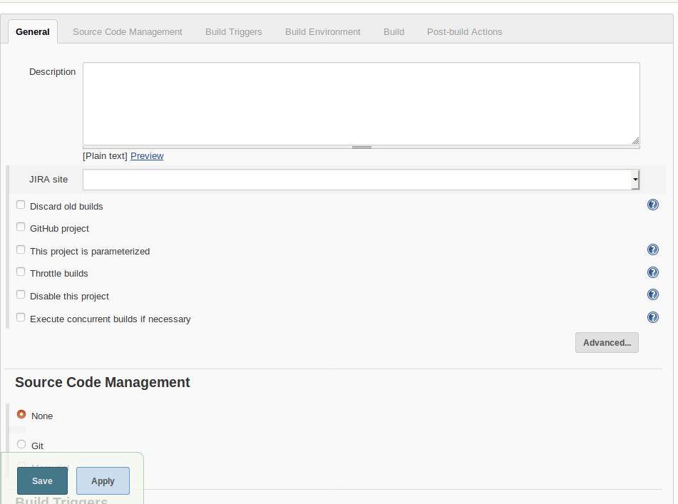
Freestyle Build Jobs
The freestyle build job can be used for any type of project and is relatively easy to set up.
The first section in the create a new freestyle job tab holds general information about the project, like the name, description, and how and where the build job has to be executed as shown below:
Notes:
Trainer Notes: Explain the slide and mention the points below
The freestyle build job is very flexible and configurable.
The project name can be anything, but note that this name will be used in the project directory and the build job URL.
The project description appears in the project home page and can be used to provide an overview of the build job’s goals and context.
HTML tags can be used in the project description field.

Slide 11
General Configurations
Discard Old Builds option:
The Discard Old Builds option gives the provision to limit the number of builds stored in the build history.
Jenkins can be configured to keep only the recent builds or a specified number of builds.
Particular builds can be kept forever using the Keep forever button on the build details page.
Notes:
Trainer Notes: Explain the slide and mention the points below
Jenkins will never delete the last stable and successful builds, no matter
how old they are. For example, if you limit Jenkins to only keep the last twenty builds,
and your last successful build was thirty builds ago, Jenkins will still keep the successful
build job as well as the last twenty failing builds.

Slide 12
General Configurations
Disable The Build option:
The Disable The Build option allows a build to be disabled so that it will not be executed until it is enabled again.
This option is usually used to temporarily suspend a build during maintenance or refactoring when notification of the build failures are not useful.
Notes:
Trainer Notes: Explain the slide

Slide 13
Advanced Configurations
The Advanced Project Options has less frequently used configuration options.
These options appear when the Advanced button is clicked on.
The Quiet Period option in the build job configuration overrides the system-wide quiet period defined in the Jenkins System Configuration screen.
The Block build when upstream project is building option is used when several related projects are affected by a single commit, but they must be built in a specific order.
Notes:
Trainer Notes: Explain the slide and mention the points below
The Quiet Period option is used for version control systems that don’t support atomic commits, such as CVS and in teams where developers commit their work in several small commits.

Slide 14
Advanced Configurations
The Block build when upstream project is building option is used when several related projects are affected by a single commit, but they must be built in a specific order.
If this option is activated, Jenkins will wait until all upstream build jobs have finished before starting the new build.
The default directory used by Jenkins can be overridden by ticking the Use custom workspace option and providing the path yourself.
The path can be either absolute or relative to Jenkins’ home directory.
Notes:
Trainer Notes: Explain the slide

Slide 15
Configuring Source Code Management
SCM configuration options in Jenkins are identical across all types of build jobs. Jenkins supports:
CVS
Subversion
Git
It also integrates with lots of other version control systems via plugins.
Notes:
Trainer Notes: Explain the slide

Slide 16
Configuring Source Code Management
SCM plugin support includes:
Accurev
Bazaar
BitKeeper
ClearCase
CMVC
Dimensions
CA Harvest
Mercurial
Perforce
Microsoft Team Foundation Server
Notes:
Trainer Notes: Explain the slide and mention the points below
Other SCM plugin support includes PVCS, StarTeam, CM/Synergy, and Visual SourceSafe.

Slide 17

Working with Subversion
Subversion is one of the most widely used version control systems. Jenkins comes with full Subversion support.
To use source code from a Subversion repository, you can simply provide the corresponding Subversion URL with any of the three Subversion protocols, http, svn, or file.
By default, Jenkins will check out the repository contents into a subdirectory of your workspace named after the last element in the Subversion URL.
Notes:
Trainer Notes: Explain the slide and mention the points below
Jenkins will validate the URL and prompt you for credentials if the repository requires authentication and stores them for future build jobs that might access this repository.
To get source code from more than one Subversion URL, you can use the Add more locations button to add as many additional repository sources as you need.
You can exclude certain regions using the Excluded Regions or Included Regions fields which take regular expressions.

Slide 18

Working with Git
Git is a popular distributed version control system and is fully supported by Jenkins.
The Git plugin is available in the Jenkins Plugin Manager page and can be installed by clicking on the install button.
After the plugin is installed, a new set of configuration options will be available on the Configure System page under Manage Jenkins.
A new Source Code Management option for Git will be displayed in the New Item page.
Notes:
Trainer Notes: Explain the slide and mention the points below
Jenkins requires your build server to have Git version 1.3.3 or later.
You need to provide the path to your Git executable. If Git is already installed on the system path, you can simply write git.
If your Git repository uses SSH passphrase-less authentication, the private half of the key will be required. The fingerprint of the remote server has to be placed in ~/.ssh/ known_hosts to prevent Jenkins from invisibly prompting for authorization.
You can configure one or more repository addresses using the URLs of the Git repositories.
The Advanced button provides more precise control of the pull behavior.

Slide 19
Create a Freestyle Build Job
Problem Statement: You have been asked to create a freestyle build job using Jenkins to compile and run a simple Java program.
Steps to perform:
Create a Git repository
Add a Java program to the repository
Create a freestyle build job in Jenkins
Build the Java program with Jenkins

Slide 20
Build Triggers

Slide 21
Build Triggers
Once the version control system is configured, you need to tell Jenkins when to start a build. This is configured in the Build Triggers section. There are three ways to trigger a build job in a freestyle job:
Start a build job once another build job has completed
Kick off builds at periodical intervals
Poll the SCM for changes
Notes:
Trainer Notes: Explain the slide

Slide 22
Start a Build Job After Another
Start a build job once another build job has completed option:
The Start a build job once another build job has completed option lets you set up a build that will be run when another build has finished.
This is configured by entering the name of the preceding build job in this field.
If the build job can be triggered by several other build jobs, a list of names, separated by commas can be used. In such cases, the build job will be triggered once any of the build jobs in the list finish.
Notes:
Trainer Notes: Explain the slide and mention the points below
This is an easy way to set up a build pipeline. For example: You can set up an initial build job to run unit and integration tests which is followed by a separate build job to run more CPU-intensive code quality metrics.
The Post-build actions section has a field called Build other projects.
This field will be automatically updated whenever you modify the Build after other projects are built field.
Unlike the Build after other projects are built field, this field gives you the option to trigger a build even if the build is unstable.

Slide 23
Scheduled Build Jobs
Scheduled builds simply triggers your build job at regular intervals. This strategy can be used for regular nightly builds.
Scheduled builds are not the same as Continuous Integration and could be done with something as simple as a Unix cronjob.
Notes:
Trainer Notes: Explain the slide

Slide 24
Scheduled Build Jobs
Continuous Integration requires faster feedback than scheduled builds. Scheduled builds can be used for long running build jobs, where quick feedback is less critical.
For example: Intensive load and performance tests.
Notes:
Trainer Notes: Explain the slide

Slide 25
Scheduled Build Jobs
Jenkins uses a cron-style syntax, consisting of five fields separated by white space in the following format, for all scheduling tasks:
MINUTE HOUR DOM MONTH DOW
The meaning of these fields are as follows:
MINUTE: Minutes within the hour (0–59)
HOUR: The hour of the day (0–23) DOM
DOM: The day of the month (1–31)
MONTH: The month (1–12)
DOW: The day of the week (0–7), where 0 and 7 are Sunday
Notes:
Trainer Notes: Explain the slide

Slide 26
Scheduled Builds
Problem Statement: You’ve been asked to schedule a freestyle build job in Jenkins that runs twice a day.
Steps to perform:
Set up a Git repository
Create a freestyle build in Jenkins
Define a regular expression for twice a day
Test the scheduled build

Slide 27
Scheduled Build Jobs
Shortcut syntax for scheduling build jobs:
Notation | Meaning | Example
* | Represents all possible values for a field | “* * * * *” means once a minute
M–N | Defines ranges | “1-5” in the DOW field would mean Monday to Friday
/ | Define skips through a range | “*/5” in the MINUTE field would mean every five minutes
Comma-separated list | Indicates a list of valid values | “15,45” in the MINUTE field would mean at 15 and 45 minutes past every hour
Shorthand values |  | @yearly, @annually, @monthly, @weekly, @daily, @midnight, and @hourly
Notes:
Trainer Notes: Explain the slide and mention the points below
Typically, there is only one line in this field, but for more complicated scheduling setups, you may need multiple lines.

Slide 28
Poll the SCM
Polling involves checking the version control server at regular intervals for any changes that have been committed.
If any changes have been made to the source code in the project, Jenkins kicks off a build.
SCM polling is easy to configure and uses the same cron syntax as scheduled builds.
Notes:
Trainer Notes: Explain the slide and mention the points below
Polling is a cheap operation and can be done frequently to ensure that a build kicks off rapidly after changes have been committed.
The more frequent the polling is, the faster the build jobs will start, and the more accurate the feedback will be about what change broke the build.
If you are using CVS, polling may not be a good option as CVS checks for changes by checking each file one by one.
This is a slow and tedious process.
The best solution is to migrate to Git or Subversion, or use polling at sparse intervals.

Slide 29
Trigger Builds Remotely
Polling as frequently as possible works well for small projects but leads to SCM server saturation as build jobs pile up in big projects.
Getting the SCM system to trigger the Jenkins build whenever a change is committed is a more precise strategy. This strategy is referred to as triggering builds remotely.
You can start a Jenkins build job remotely by invoking a URL of the form:
http://SERVER/jenkins/job/PROJECTNAME/build
Notes:
Trainer Notes: Explain the slide and mention the points below
Polling as frequently as possible also wastes network resources, and there is always a small delay between code change being committed and starting the build job.

Slide 30
Trigger Builds Remotely
The details of triggering builds remotely are different for each version control system.
In Subversion, you would need to write a post-commit hook script that would trigger a build.
A more flexible approach with Subversion is to use the Jenkins Subversion API directly.
This would automatically start any Jenkins build jobs monitoring this Subversion repository.
This is set up by activating the Trigger builds remotely option and providing a special string that can be used in the URL
Notes:
Trainer Notes: Explain the slide and mention the points below
If you have activated Jenkins security, you will need to provide a username and password.

Slide 31
Polling SCM
Problem Statement: You have been asked to configure a freestyle build job in Jenkins that polls the SCM every night.
Steps to perform:
Create a Maven project
Configure a freestyle job that run Maven build steps
Define the regular expression for nightly builds
Test the scheduled build

Slide 32
Build Steps

Slide 33

Manual Build Jobs
A build does not have to be triggered automatically.
Some build jobs should only be started manually by human intervention.
For example: you may want to set up an automated deployment to a UAT environment that should only be started on the request of the QA.
In such cases, you can simply leave the Build Triggers section empty.
Notes:
Trainer Notes: Explain the slide and mention the points below
user acceptance testing (UAT)

Slide 34
Build Steps
Build steps are the basic building blocks for the Jenkins freestyle build process.
They are how you inform Jenkins exactly how you want your project built.
A build job may have one or more steps.
A build job may even occasionally have no steps.
In a basic Jenkins installation, you will be able to add steps to invoke Maven and Ant, as well as run OS-specific shell or Windows batch commands.
By installing additional plugins, you can also integrate other build tools, such as Groovy, Gradle, Grails, Jython, MSBuild, Phing, Python, Rake, and Ruby.
Notes:
Trainer Notes: Explain the slide and mention the points below
In a freestyle build, you can add as many build steps as you want to the Build section of your project configuration.

Slide 35
Maven Build Steps
Jenkins has excellent Maven support. Maven build steps are easy to configure and very flexible. The steps to define a Maven build are:
Pick a version of Maven to run if you have multiple versions installed. Jobs work with both Maven 2 and Maven 3.
2
Enter the Maven goals you want to run. You can specify as many goals as you want.
Pick the Invoke top-level Maven targets from the build step lists.
3
1
Notes:
Trainer Notes: Explain the slide

Slide 36
Maven Build Steps
Command-line options can also be provided in the Maven build steps. Some useful Maven options are:
-B or --batch-mode:
This option informs Maven not to prompt for any input from the user and to just use the default values if required.
If Maven does prompt for any input during the Jenkins build, the build hangs indefinitely.
-U or --update-snapshots:
This option forces Maven to check for updated releases and snapshot dependencies on the remote repository.
This makes sure that you are building with the latest snapshot dependencies and not any older local copies which may not by in sync with the latest version of source code.
Notes:
Trainer Notes: Explain the slide

Slide 37
Maven Build Steps
-Dsurefire.useFile=false
This option forces Maven to write JUnit output to the console, rather than to text files in the target directory.
Any test failure details are directly visible in the build job console output.
This will still generate the XML files that Jenkins needs for its test reporting.
Notes:
Trainer Notes: Explain the slide

Slide 38
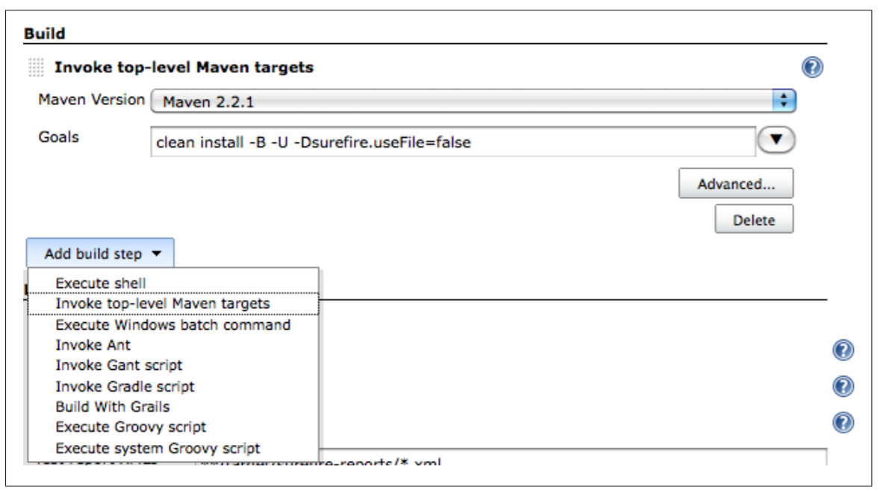
Maven Build Steps
The screenshot below shows adding a build step to a freestyle build job:
Notes:
Trainer Notes: Explain the slide

Slide 39
Ant Build Steps
Freestyle build jobs work well with Ant.
Apache Ant is a popular Java build scripting tool. A large number of Java projects rely on Ant build scripts.
great management tools to run the applications
Ant is not only used as a primary build scripting tool, but can also be used to do other tasks. Even if your project uses Maven, you can call Ant scripts to do more specific tasks.
Ant libraries are available for many development tools and low-level tasks, such as using SSH, or working with proprietary application servers.
Notes:
Trainer Notes: Explain the slide

Slide 40
Ant Build Steps
Configuring a basic Ant build step:
Provide the version of Ant you want to use.
Give the name of the target you want to invoke.
Advanced button:
Advanced options include specifying a different build script, or a build script in a different directory other than the default build.xml in the root directory.
You can also specify the properties and JVM options just as you can for Maven.
Notes:
Trainer Notes: Explain the slide

Slide 41
Jenkins Environment Variables

Slide 42
Using Jenkins Environment Variables in Your Builds
In any build step, you can obtain information from Jenkins about the current build job. When Jenkins starts a build step, the following environment variables become available to the build script:
Environment Variable | Value
BUILD_NUMBER | The current build number.
BUILD_ID | A timestamp for the current build id in the format YYYY-MM-DD_hh-mm-ss.
JOB_NAME | The name of the job.
BUILD_TAG | A way to identify the current build job in the form of Jenkins -${JOB_NAME}-${BUILD_NUMBER}.
EXECUTOR_NUMBER | A number identifying the executor running the build among the executors of the same machine.
Notes:
Trainer Notes: Explain the slide

Slide 43
Using Jenkins Environment Variables in Your Builds
Environment Variable | Value
NODE_NAME | The name of the slave if the build is running on a slave or "" if the build is running on master.
NODE_LABELS | The list of labels associated with the node that the build is running on.
JAVA_HOME | The JAVA_HOME of the specified JDK. When this variable is set, PATH is also updated to $JAVA_HOME/bin.
WORKSPACE | The absolute path of the workspace
JENKINS_URL | The full URL of the Jenkins server.
JOB_URL | The full URL for this build job.
BUILD_URL | The full URL for this build.
Notes:
Trainer Notes: Explain the slide and mention the points below
SVN_REVISION: For Subversion-based projects, this variable holds the current revision number.
CVS_BRANCH: For CVS-based projects, this variable holds the branch of the module. If CVS is configured to check out the trunk, this environment variable is not set.

Slide 44
Using Jenkins Environment Variables in Your Builds
These variables are easy to access. You can access them in an Ant script using the
<property> tag as follows:
<target name="printinfo">
<property environment="env" />
<echo message="${env.BUILD_TAG}"/>
</target>
Notes:
Trainer Notes: Explain the slide

Slide 45
Using Jenkins Environment Variables in Your Builds
In Maven, you can access the variables using the env. prefix or using the Jenkins environment variable. In the following pom.xml file, the project URL will point to the Jenkins build job that ran the mvn site build:
<project...>
...
<groupId>com.simpli.hello</groupId>
<artifactId>hello-core</artifactId>
<version>0.0.55-SNAPSHOT</version>
<name>hello-core</name>
<url>${JOB_URL}</url>
Notes:
Trainer Notes: Explain the slide

Slide 46
Post Build Actions

Slide 47

Post Build Actions
Once the build is completed, you might want to perform the following actions:
Archive some of the generated artifacts.
Report on test results.
Notify people about the results.
Notes:
Trainer Notes: Explain the slide

Slide 48
Reporting on Test Results
Reporting on test results is one of the most important requirements of a build job.
A build job should report test failures as well as number of tests executed, time taken for their execution, and other details.
Jenkins provides great support for test reporting. Check the Publish JUnit test result report option, and provide a path to your JUnit report files.
You can use a wildcard expression to include JUnit reports from a number of different directories and Jenkins will aggregate the results into a single report.
Notes:
Trainer Notes: Explain the slide and mention the points below
JUnit is the most commonly used testing library for Java and the JUnit XML format for test results is widely used and understood by other tools as well.

Slide 49
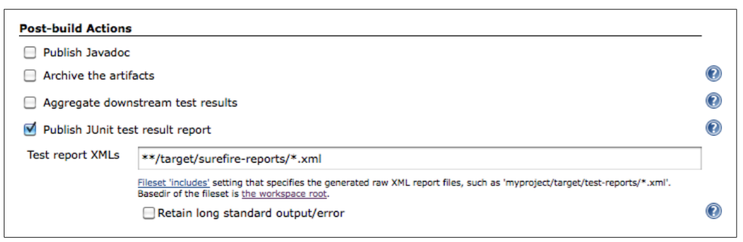
Reporting on Test Results
The screenshot below shows the Post-build Actions page for reporting on test results:
Notes:
Trainer Notes: Explain the slide

Slide 50
Archiving Build Results
The primary goal of a build job is generally to build something, such as, an artifact.
A build job can store one or many different artifacts.
It can keep only the latest copy or every artifact ever built.
You can configure Jenkins to store your artifacts by checking the Archive the artifacts checkbox in the Post-build Actions, and specifying the artifacts you want to store.
An artifact might be a binary executable, like a JAR or WAR file, for a Java project or some related deliverable, like documentation or source code.
Notes:
Trainer Notes: Explain the slide and mention the points below
You can provide the complete paths of the files you want to archive in the Files to archive field.

Slide 51
Archiving Build Results
Wildcards:
You can also use wildcards to specify the files to archive.
Using wildcards makes your build less dependent on version control set up.
Exclude option:
If you are using wildcards to find your artifacts, there might be directories that you would have to exclude from the search.
This is done by filling in the Excludes field. Enter a pattern to match the files that you don’t want to archive.
Notes:
Trainer Notes: Explain the slide

Slide 52
Archiving Build Results
Discard option:
Archived artifacts can take a lot of disk space, especially, if the builds are frequent.
Checking the Discard all but the last successful/stable artifact option limits the amount of artifacts stored.
Jenkins can then, only keep artifacts from the last stable build, the artifacts of the latest unstable build following the stable build, and the artifacts from the last failed build that happened.
Notes:
Trainer Notes: Explain the slide

Slide 53
Archiving Build Results
Archived build artifacts appear on the build results page.
The most recent build artifacts are also displayed on the build job home page.
You can also use permanent URLs to access the most recent build artifacts.
This lets you reuse the latest artifacts from your builds, either in other Jenkins build jobs or in external scripts.
There are three URLs available:
Last stable build
Last successful build
Last completed build
Notes:
Trainer Notes: Explain the slide

Slide 54
Archiving Build Results
The format of the artifact URLs takes the following form:
Latest stable build:
<server-url>/job/<build-job>/lastStableBuild/artifact/<path-to-artifact>
Latest successful build:
<server-url>/job/<build-job>/lastSuccessfulBuild/artifact/<path-to-artifact>
Latest completed build:
<server-url>/job/<build-job>/lastCompletedBuild/artifact/<path-to-artifact>
Notes:
Trainer Notes: Explain the slide

Slide 55
Stable and Successful Builds
Unit test failures, insufficient code coverage, or other code quality metrics issues, could cause a build to be marked as unstable.
A stable build is always successful, but a build can also be successful without being stable.
A build is successful when the compilation reports no errors.
A build is stable if it was built successfully, and no publisher reported it as unstable.
A completed build is simply a build that has finished, no matter what its result.
The archiving step will run regardless of the outcome of the build.
Notes:
Trainer Notes: Explain the slide

Slide 56
Notifications
The most important use of a CI server is to notify people when a build breaks. This comes under the Notification page in Jenkins.
Jenkins provides support for email notifications out of the box.
This can be activated by checking the E-mail Notification checkbox in the Post-build Actions.
Enter the email addresses of the team members who will need to know when the build breaks.
When the build breaks, Jenkins will send an email to the users in this list with a link to the broken build.
Notes:
Trainer Notes: Explain the slide and mention the points below
You can opt to send a separate email to the user who’s commit broke the build.
You will need to activate Security on your Jenkins server to do this.
Jenkins will usually send an email whenever a build fails one when the build becomes unstable for the first time.
Examples of unstable builds are unit test failures.
Jenkins will not send emails for every unstable build, but only the first one.
Jenkins will also send a message when a previously failing or unstable build succeeds, to notify that the problem has been resolved.

Slide 57
Building Other Projects
Other build jobs can be started in the Post-build Actions. This is done using the Build other project option.
This can be used to organize your build process in several, smaller steps, rather than one long build job.
These projects will only be triggered if the build was stable.
You also have the option to trigger another build job even if the current build is unstable.
This might be useful to run a code quality metrics reporting build job after a project’s main build job, even if there are test failures in the main build.
Notes:
Trainer Notes: Explain the slide

Slide 58
Post-Build Actions
Problem Statement: You have been asked to configure a freestyle build job with post-build actions.
Steps to perform:
Configure SMTP settings to enable email alerts in Jenkins
Define a freestyle build job
Configure post-build actions to send email alerts if build fails
Test the job and the SMTP settings

Slide 59
Using Jenkins with Other Languages

Slide 60
Using Jenkins with Other Languages
Visual Studio MSBuild
Gradle
NAnt
Ruby on Rails
Grails
Jenkins provides excellent support for languages other than Java using Maven. A few of the more common ones are given above.
Notes:
Trainer Notes: Explain the slide

Slide 61
Building Projects with Grails

Slide 62

Building Projects with Grails
Grails is an open source dynamic web application framework built on Groovy and other open source Java frameworks, like Spring and Hibernate.
Jenkins provides excellent support for Grails builds with the Jenkins Grails plugin.
The Grails plugin adds the Build with Grails build step, which lets you build your Grails application.
Provide the Grails target you want to execute. Unlike the command line, several targets can be executed with the same command.
Notes:
Trainer Notes: Explain the slide and mention the points below
You will need at least one version of Grails for Jenkins to use in the Grails Builder section in the Configure System page.
If you need to pass any arguments to a particular target, you can enclose the target and its arguments in double quotes.
The Grails build step takes many optional parameters like specifying version upgrades, the server port and any other properties you want to pass to the build.

Slide 63
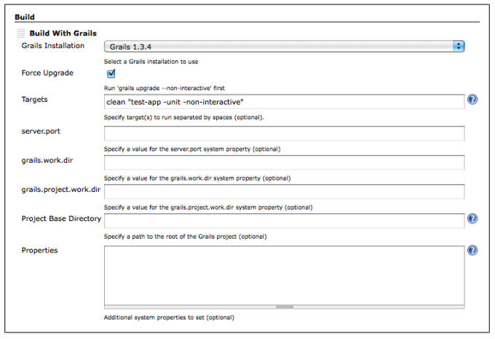
Building Projects with Grails
The screenshot below shows creating a freestyle build job with the Jenkins Grails plugin:
Notes:
Trainer Notes: Explain the slide

Slide 64
Building Projects with Gradle

Slide 65
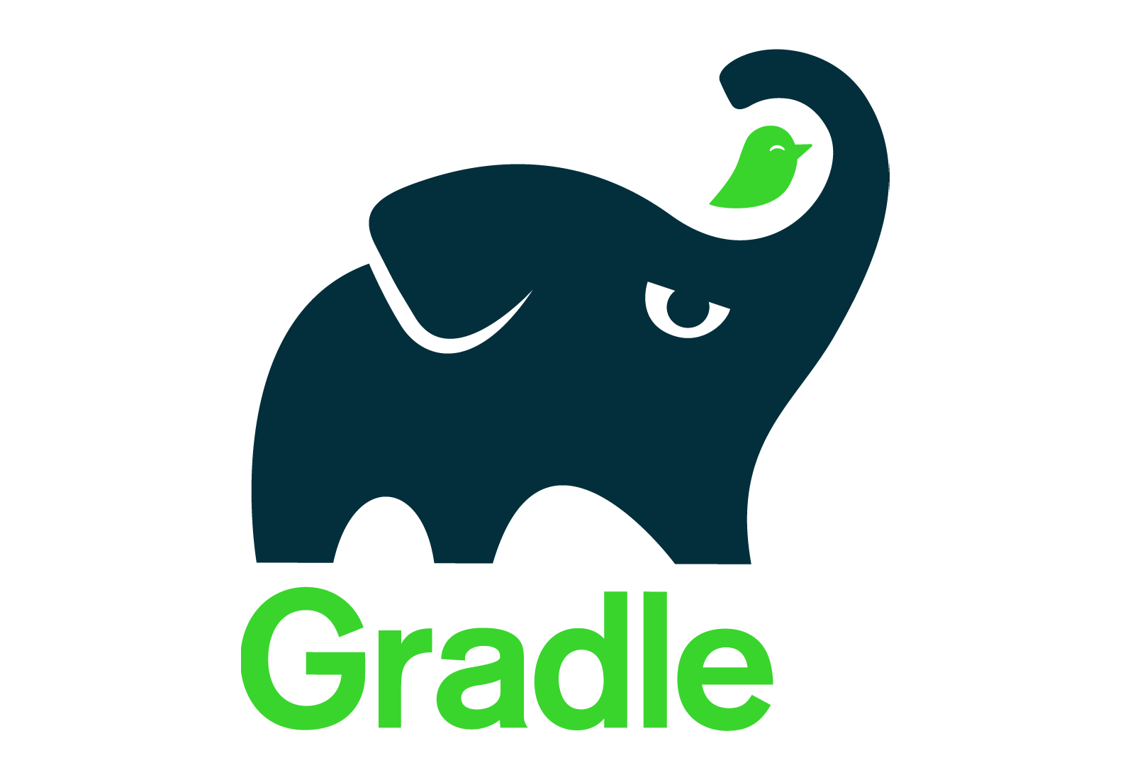
Building Projects with Gradle
Gradle is a relatively new open source build tool for the Java Virtual Machine compared to Ant and Maven.
Build scripts for Gradle are written in a Domain Specific Language (DSL) based on Groovy.
Gradle implements convention over configuration, allows direct access to Ant tasks, and uses Maven-like declarative dependency management.
There are two different ways to run your Gradle builds with Jenkins: The Gradle plugin for Jenkins and the Gradle wrapper functionality
Notes:
Trainer Notes: Explain the slide

Slide 66
The Gradle Plugin For Jenkins
The Gradle plugin for Jenkins can be installed from the Manage Plugins page.
Click Install and restart your Jenkins instance to use the Gradle plugin.
Click the Add Gradle button to add a new Gradle installation, and enter an appropriate name.
A new Gradle section will be added in the Configure System screen.
On adding a build step to a Freestyle build job, you will have a new option called Invoke Gradle script, which lets you add Gradle specific settings to your build job.
Notes:
Trainer Notes: Explain the slide and mention the points below
You will need to add the Gradle installation you want to use.
Click the Add Gradle button to add a new Gradle installation, and enter an appropriate name.
You can point to the local Gradle home directory if it’s installed or use the Install automatically feature to download a Gradle installation.

Slide 67
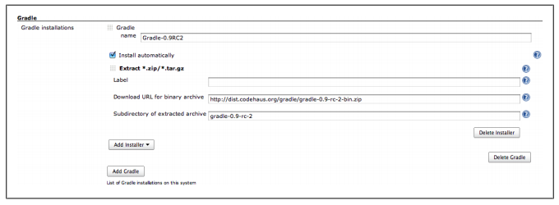
Configuring the Gradle Plugin
The screenshot below shows how to configure the Gradle plugin for Jenkins:
Notes:
Trainer Notes: Explain the slide

Slide 68
Gradle Build
Problem Statement: You have been asked to set up a freestyle job that build projects with Gradle in Jenkins.
Steps to perform:
Configure Gradle plugin for Jenkins
Create a Gradle project
Build a project with Gradle in Jenkins

Slide 69
Incremental Builds
Gradle runs its builds incrementally while running a Gradle build job with unchanged sources.
If the output of a Gradle task is still available and the sources haven’t changed since the last build, Gradle can skip the task execution.It marks the task as up-to-date.
This incremental build feature can decrease the duration of a running build job considerably.
If Gradle evaluates the test task as up-to-date, the execution of unit tests is also skipped.
This can cause problems when running Gradle build and the Jenkins job may be marked as failed.
Notes:
Trainer Notes: Explain the slide

Slide 70
Building Projects with MSBuild

Slide 71
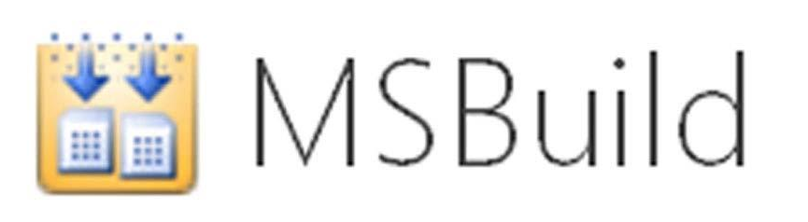
Building Projects with MSBuild
Although Jenkins is primarily a Java application, it provides excellent support for .NET projects.
Install the MSBuild plugin to build .NET projects in Jenkins.
The MSTest plugin and the NUnit plugin can help display your test results.
Once the .NET plugins are installed, Jenkins can be configured for .NET build tools.
Notes:
Trainer Notes: Explain the slide

Slide 72
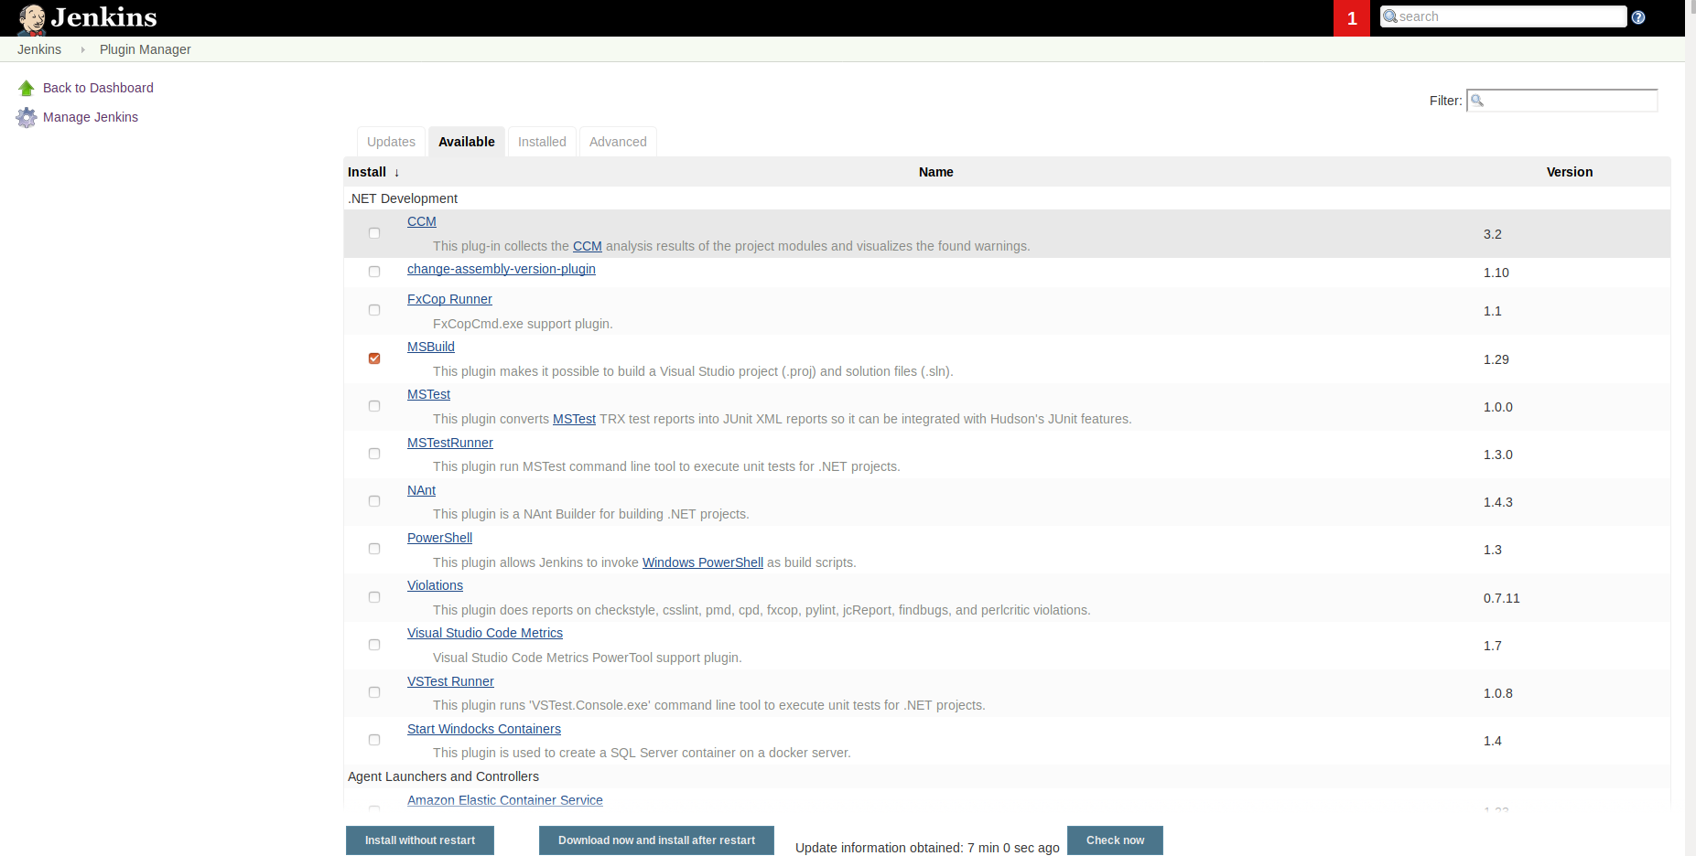
Building Projects with MSBuild
The screenshot below shows the plugins listed in the Manage Plugins screen. Select the required plugins and click on Install.
Notes:
Trainer Notes: Explain the slide

Slide 73
Parameterized Build Jobs

Slide 74
Parameterized Build Jobs
The Parameterized Build plugin lets you configure parameters for a build job that are either entered by the user when the build job is triggered, or from another build job.
For a deployment build job, you can either choose the target environment from a drop-down list or specify the version of the application.
When running a build job involving web tests, you can specify the browser to run the Selenium or WebDriver tests in. You can also upload files to be used by build jobs.
Jenkins simply provides an interface to enter values for the parameters. It is the job of the build script to analyze and process the parameter values correctly.
Notes:
Trainer Notes: Explain the slide and mention the points below
Parameterized builds is a powerful new concept that adds another dimension to your build jobs.

Slide 75
Creating a Parameterized Build Job
Install the Build with Parameters plugin via the Plugin Manager screen.
Select the This build is parameterized option and click on Add Parameter to add a new build job parameter.
Pick the parameter type in the drop-down list to add a parameter to your build job.
Configure the details of the parameter. You can choose from several different parameter types, like Strings, Booleans, and drop-down lists.
Enter the configuration details based on the type you choose. All parameter types, with the exception of the File parameter, have a name and a description, and most often a default value.
Notes:
Trainer Notes: Explain the slide and mention the points below
.
You can add as many parameters as you want to any sort of build.

Slide 76
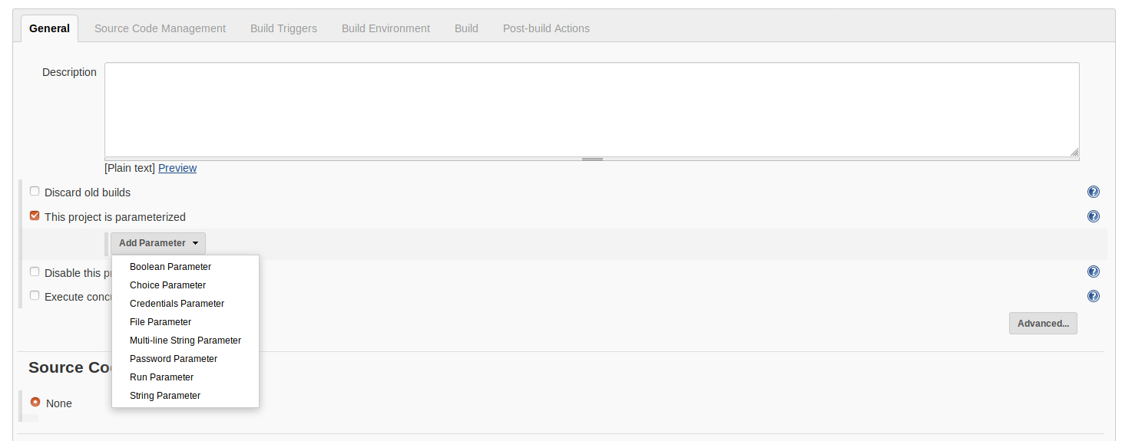
Creating a Parameterized Build Job
The screenshot below shows how to create a parameterized build in Jenkins:
Notes:
Trainer Notes: Explain the slide

Slide 77
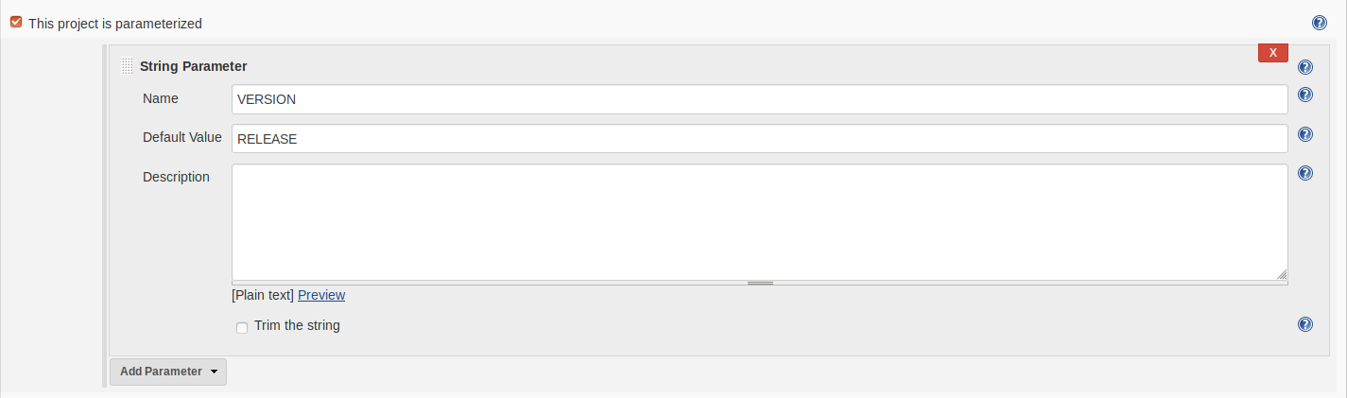
Creating a Parameterized Build Job
The screenshot below shows adding a String parameter, VERSION, to a parameterized build:
Notes:
Trainer Notes: Explain the slide

Slide 78
Parameterized Builds
Problem Statement: You have been asked to create and run a parameterized build in Jenkins.
Steps to perform:
Create a freestyle build in Jenkins
Define a string parameter
Build the project

Slide 79
Adapting Builds for Parameterized Build Scripts
Once you have added a parameter, you need to configure the build scripts to use it.
Choosing the parameter name is important as Jenkins will pass this name through as an environment variable when it runs the build job.
It is good practice to put them all in upper case to make the environment variables portable across operating systems.
You can also use environment variables from your build scripts.
Notes:
Trainer Notes: Explain the slide

Slide 80
Adapting Builds for Parameterized Build Scripts
In an Ant or Maven build, you can use the special env property to access the current environment variables:
Another option is to pass the parameter into the build script as a property value.
<target name="printversion">
<property environment="env" />
<echo message="${env.VERSION}"/>
</target>
Notes:
Trainer Notes: Explain the slide

Slide 81
Building from a Subversion Tag
The parameterized trigger provides a special support for Subversion that allows you to build against a specific Subversion tag.
This support for Subversion is useful if you want to run a release build using a tag generated by a previous build job. For example, an upstream build job may tag a particular revision.
You can configure a Jenkins build to run against a selected tag by using the List Subversion Tag parameter type and providing the Subversion repository URL pointing to the tags directory of your project.
Alternatively, you can use the standard Maven release process to generate a new release.
Notes:
Trainer Notes: Explain the slide and mention the points below
Alternatively, you might use the standard Maven release process to generate a new release. In this case, a tag with the Maven release number will automatically be generated in Subversion.This approach is useful for projects that need to be partially or entirely rebuilt before they can be deployed to a given platform. For example, you may need to run the Antor Maven build using different properties or profiles for different platforms, so that platform-specific configuration files can be embedded in the deployed WAR or EARfiles.

Slide 82
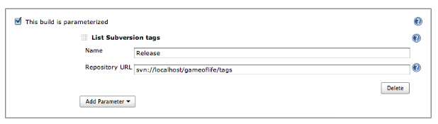
Building From A Subversion Tag
The screenshot below shows how to use parameters to build from a Subversion tag.
Notes:
Trainer Notes: Explain the slide

Slide 83
Building From A Git Tag
Building from a Git tag is not as simple as building from a Subversion tag. However, you can use parameters to indicate the tag to use.
When Jenkins obtains a copy of the source code from Git, it clones the Git repository, including all the tags.
Once you have the latest version of the repository on your Jenkins server, you can proceed to checkout a tagged version using gitcheckout <tagname>.
To do this in Jenkins, you need to add a String parameter to your build job.
Notes:
Trainer Notes: Explain the slide and mention the points below
Unlike the Subversion support, there is no way to list the available Git tags in a drop-down list and users need to know the name of the tag to release.

Slide 84
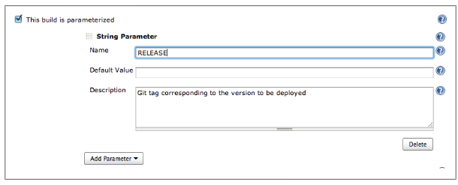
Building From A Git Tag
The screenshot below shows how to configure the parameter for a Git tag:
Notes:
Trainer Notes: Explain the slide

Slide 85
Building From Tags
Problem Statement: You have been asked to configure a build job in Jenkins that builds from a Git tag.
Steps to perform:
Add the Git parameter plugin to Jenkins
Create a tag in a Git repository
Configure a freestyle build job to read from the tag
Test the project and build from the Git tag

Slide 86
Starting a Parameterized Build Job Remotely
You can start a parameterized build job remotely, by invoking the URL of the build job.
Note that the parameter names in the URL are case-sensitive, and the values need to be escaped like any HTTP parameter.
If you are using a Run parameter, you need to provide the name of the build job as well as the run number.
The typical form of a parameterized build job URL is:
http://jenkins.acme.org/job/myjob/buildWithParameters?PARAMETER=Value
Notes:
Trainer Notes: Explain the slide

Slide 87
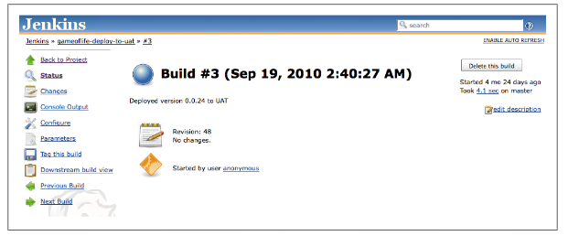
Parameterized Build Job History
It is important to know what parameters were used to run a particular parameterized build. Jenkins stores these values in the build history, as shown below:
Notes:
Trainer Notes: Explain the slide

Slide 88
Parameterized Triggers
When triggering another build job from within a parameterized one, it is helpful to have the provision to pass the parameters of the current build job to the new one.
If you have an application that needs to be tested against several different databases, you can set up a parameterized build job that accepts the target database as a parameter.
You will need to start a series of builds, all of which will need this parameter.
You cannot do this using the conventional Build other projects option in the Post-Build Actions section. This can be done using the Jenkins Parameterized Trigger plugin.
Notes:
Trainer Notes: Explain the slide and mention the points below
The plugin lets you configure your build jobs to both trigger parameterized builds, and to pass arbitrary parameters to these builds.
The plugin gives the option of Triggering parameterized builds on other projects in your build job configuration page.
This lets you start a subsequent build job and passes the current parameters to this new build job.

Slide 89
Remote Triggering Parameterized Builds
Problem Statement: You have been asked to configure a parameterized build in Jenkins that can be triggered remotely.
Steps to perform:
Create a freestyle build in Jenkins
Define a string parameter
Trigger the parameterized build remotely

Slide 90
Enabling Security in Jenkins

Slide 91
Enabling Security in Jenkins
Setting up basic security in Jenkins is easy.
In the main configuration page, check the Enable security checkbox. This will display a number of options.
The first section, Security Realm, determines where Jenkins will look for users during authentication. The options include :
Using users stored in an LDAP server
Using a simple built-in user database managed by Jenkins
Using the underlying Unix user accounts
Notes:
Trainer Notes: Explain the slide

Slide 92
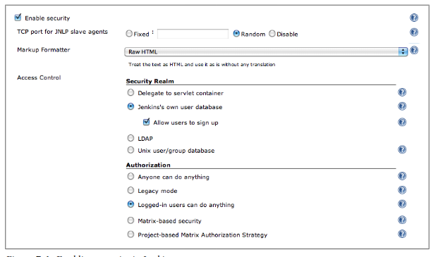
Enabling Security in Jenkins
The screenshot below shows how to enable security in Jenkins:
Notes:
Trainer Notes: Explain the slide

Slide 93
Different Levels of Authentication
The second section, Authorization, determines what users can do once they are logged in.
This ranges from simple options like Anyone can do anything or Logged-in users can do anything, to more sophisticated roles and project-based authorization policies.
The screenshot below shows the levels of authorization in Jenkins:
Notes:
Trainer Notes: Explain the slide and mention the points below
Letting signed-in users do anything is certainly flexible and may work for a small team.
For larger or multiple teams, or cases where Jenkins is being used outside the development environment, Matrix-based security is a good approach that allows different users to be assigned different rights, using a role-based approach.

Slide 94
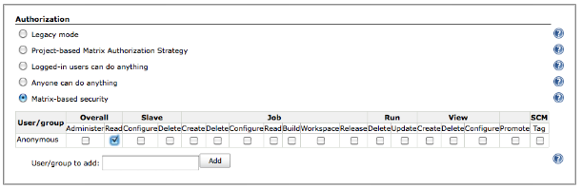
Matrix-based Security
The first step to setup matrix-based security in Jenkins is to create an administrator.
You can activate matrix-based security by selecting Matrix-based security in the Authorization section.
Jenkins will display a table containing authorized users, and checkboxes corresponding to the various permissions that you can assign to these users as shown below:
Notes:
Trainer Notes: Explain the slide

Slide 95
User Permissions
The individual permissions you can assign a Jenkins user are as follows:
Overall: This group covers basic system-wide permissions.
Administer: Lets a user make system-wide configuration changes and other sensitive operations.
Read: Provides read-only access to virtually all of the pages in Jenkins.
Slave: This group covers permissions about remote build nodes, or slaves.
Configure: Create and configure new build nodes.
Delete: Delete build nodes.
Notes:
Trainer Notes: Explain the slide

Slide 96
User Permissions
Job: This group covers job-related permissions.
Create: Create a new build job.
Delete: Delete an existing build job.
Configure: Update the configuration of an existing build jobs.
Read: View build jobs.
Build: Start a build job.
Workspace: View and download the workspace contents for a build job.
Release: Start a Maven release for a project configured with the M2Release plugin.
Notes:
Trainer Notes: Explain the slide

Slide 97
User Permissions
Run: This group covers rights related to particular builds in the build history.
Delete: Delete a build from the build history.
Update: Update the description and other properties of a build in the build history.
View: This group covers managing views.
Create: Create a new view.
Delete: Delete an existing view.
Configure: Configure an existing view.
SCM: This group covers permissions related to your version control system.
Tag: Create a new tag in the source code repository for a given build.
Notes:
Trainer Notes: Explain the slide and mention the points below
Others: There can also be other permissions available, depending on the plugins installed.
Promote: If the Promoted Builds plugin is installed, this permission allows users to manually promote a build.

Slide 98

Role-based Security
The Role Strategy plugin allows you to define global and project-level roles, and assign these roles to users.
You can install the plugin via the Plugin Manager and activate this authorization strategy in the main configuration page.
Once this is set up, you can define roles that regroup sets of related permissions.
You can setup and configure roles with global and project-level permissions, and assign these roles to your users, on the Manage Roles screen.
Notes:
Trainer Notes: Explain the slide

Slide 99

Project-based Security
Project-based security builds on the matrix-based security model and lets you apply it to individual projects.
You can assign system-wide roles for your users as well as configure specific rights for certain individual projects.
To activate project-level security, select Project-based Matrix Authorization Strategy in the Authorization section and select from the default rights for users and groups.
To setup project-specific permissions, select Enable project-based security in the project configuration screen and Jenkins will display a table of project-specific permissions.
Notes:
Trainer Notes: Explain the slide

Slide 100
Enabling Security
Problem Statement: You have been asked to define the security policies in Jenkins.
Steps to perform:
Configure Security Realm to use Jenkins’ own user database and allow users to sign up.
Configure Authorization to allow Logged-in users to do anything.
Set up a new user account

Slide 101
Build Pipelines and Promotions

Slide 102

Build Promotion
The Promoted Builds plugin lets you identify specific builds that have met additional quality criteria, and trigger actions on these builds. For example:
A default build job runs unit and some integration tests and produces a WAR file.
This WAR file is then reused for more extensive integration tests and then for a series of automated web tests.
I
If the build passes the automated web tests, you may deploy the application to a functional testing environment where it can be tested by human testers.
The deployment to this environment is implemented in the final build job.
Once the testers have validated a version, it can be promoted into UAT, and then into production.
Notes:
Trainer Notes: Explain the slide

Slide 103
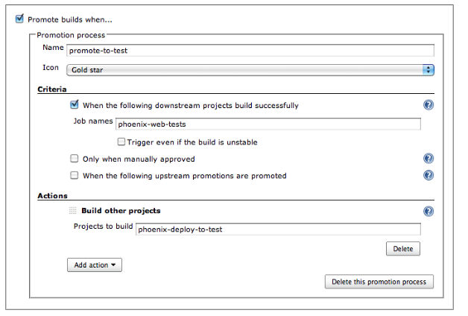
Configuring Build Promotions
The screenshot below shows how to configure a build promotion:
Notes:
Trainer Notes: Explain the slide

Slide 104
Configuring Build Promotions
Build promotion can be either automatic, based on the result of a downstream build job, or manually activated by a user.
The build promotion for the build job in the screenshot will be automatically triggered when the automated web tests are successful.
You can also have certain build jobs that can only be promoted manually.
Manual build promotion is used for cases where human intervention is needed to approve a build promotion. Deployment to UAT or production are common examples.
You also need to tell Jenkins what to do when the build is promoted. This is done by adding actions, making build promotions extremely flexible.
Notes:
Trainer Notes: Explain the slide and mention the points below
Common actions include invoking Maven or Ant scripts, deploying artifacts to a Maven repository, or triggering another build job.

Slide 105
Build Pipelines
A deployment pipeline is a way of orchestrating your build through a series of quality gates, with automated or manual approval processes at each stage, resulting in deployment into production.
The Build Pipeline plugin provides an alternative way to define downstream build jobs.
03
The Build Pipelines plugin takes the idea of build promotion further and helps you design and monitor deployment pipelines.
01
01
02
Notes:
Trainer Notes: Explain the slide

Slide 107
Which of the following is NOT a type of Jenkins build job?
1
Freestyle jobs
Pipelines
External jobs
Maven projects

Slide 108
Which of the following is NOT a type of Jenkins build job?
1
Freestyle jobs
Pipelines
External jobs
Maven projects
A
While Pipelines and jobs can be used to achieve the same functionality, they’re inherently different. A Pipeline is a Groovy-based definition of steps in a build.

Slide 109
Which of the following is NOT a post-build action?
2
Archive build results
Send notifications
Delete workspace before build
Delete workspace after build

Slide 110
Which of the following is NOT a post-build action?
2
Archive build results
Send notifications
Delete workspace before build
Delete workspace after build
C
‘Delete workspace before build’ is a Build Environment configuration option.

Slide 111
A multi-configuration job is also known as a ___________________.
3
Hierarchical Job
Recursive Job
Multi-file Job
Matrix Job

Slide 112
A multi-configuration job is also known as a ___________________.
3
Hierarchical Job
Recursive Job
Multi-file Job
Matrix Job
D
A multi-configuration job is also known as a matrix job.

Slide 113
How many artifacts can one build job store using the Archive the artifacts option?
4
One
Three
Five
Unlimited

Slide 114
How many artifacts can one build job store using the Archive the artifacts option?
4
One
Three
Five
Unlimited
A
You can only save one artifact per build job using the Archive the artifacts option. However, you can use wildcards to save any number of artifacts.

Slide 115
Jenkins supports four types of build jobs: Freestyle software project, Maven project, External job, and Multi-configuration job.
Once a build is completed, you can archive some of the generated artifacts, report on test results, and notify people about the results.
Jenkins also provides excellent support for languages like Grails, Gradle, MSBuild, NAnt, and Ruby on Rails.
The Parameterized Build plugin lets you configure parameters for a build job, that are either entered by the user when the build job is triggered or from another build job.

Slide 116

Triggering Parameterized Builds
Triggering Parameterized Builds
Lesson-End Project
Problem Statement:
You’re a DevOps engineer at ChefHelp, which is a web and mobile-based app company that provides users with various recipes and cooking tips. The company wants to automate categorizing recipes. You’re required to set up a Jenkins job stream where a job gets triggered when a new recipe is added to the database. The job has to accept the file path as a parameter, run the program to find the category it belongs to, return the result and trigger another job to delete the recipe file from the server to avoid server space issues.
Requirements:
The program should accept the file path as a command line argument.
The parameterized build job should be designed to be triggered remotely.
The delete temps job should be triggered only if the build job succeeds.
Problem Statement:
You’re a DevOps engineer at ChefHelp, which is a web and mobile-based app company that provides users with various recipes and cooking tips. The company wants to automate categorizing recipes. You’re required to set up a Jenkins job stream where a job gets triggered when a new recipe is added to the database. The job has to accept the file path as a parameter, run the program to find the category it belongs to, return the result and trigger another job to delete the recipe file from the server to avoid server space issues.
Requirements:
The program should accept the file path as a command line argument.
The parameterized build job should be designed to be triggered remotely.
The delete temps job should be triggered only if the build job succeeds.
Notes:
Trainer Notes: Explain the project to the learners, and instruct them to perform it after the lesson.

